Slide 1
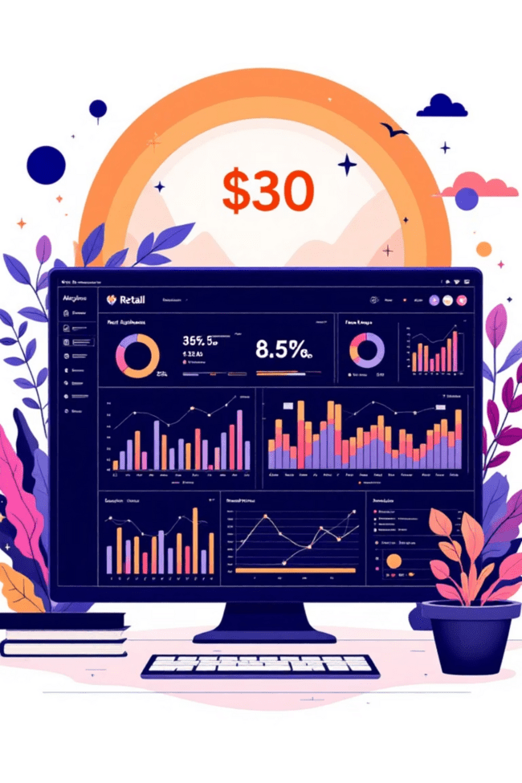
Customer Shopping Behavior Analysis
Uncovering insights from 3,900 purchases to guide strategic business decisions through data-driven analysis of spending patterns, customer segments, and product preferences.

Slide 2

Dataset Overview
3,900
18
50
Total Purchases
Data Features
Locations
Comprehensive transactional data analyzed
Columns tracking customer and purchase details
Geographic diversity across customer base
25
Product Types
Items across multiple categories

Slide 3

Data Preparation & Cleaning
Python Analysis Steps
Loaded dataset using pandas library
Explored structure with df.info() and .describe()
Imputed 37 missing Review Rating values using median
Standardized columns to snake case format
Created age_group and purchase_frequency_days features
Connected to MySQL database for advanced SQL analysis after cleaning and feature engineering.

Slide 4

Revenue Insights by Demographics
Gender Revenue Split
Male customers: $157,890
Female customers: $75,191
Males generate 2.1x more revenue than females
Age Group Performance
Young Adult: $62,143
Middle-aged: $59,197
Adult: $55,978
Senior: $55,763

Slide 5




Customer Segmentation Analysis
Returning Buyers
701 customers (18.0%)
Growing segment showing repeat purchase behavior
Loyal Customers
3,116 customers (79.9%)
Highest value segment with consistent purchase history
New Customers
83 customers (2.1%)
Fresh acquisition opportunities for growth

Slide 6

Product Performance Metrics
Top-Rated Products
01
02
Gloves
Sandals
3.86 average rating
3.84 average rating
03
04
Boots
Hat
3.82 average rating
3.80 average rating
05
Skirt
3.78 average rating
Customer satisfaction remains strong across top products with ratings above 3.75 average.

Slide 7
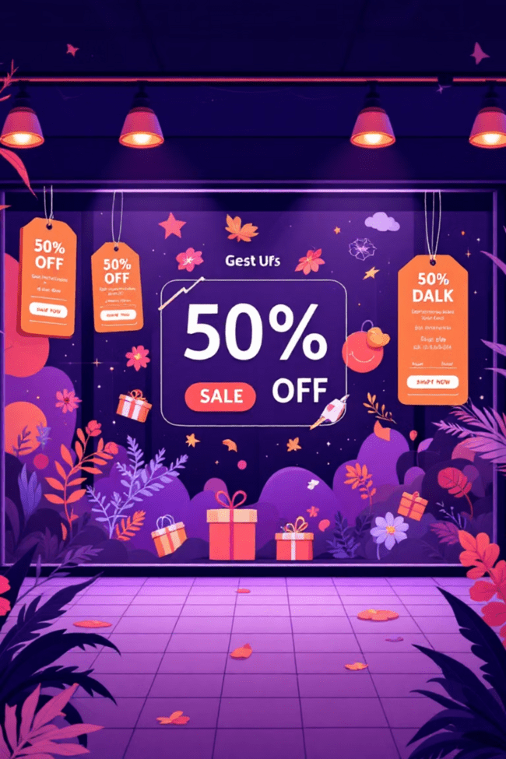
Discount & Promotion Analysis
High-Value Discount Users
839 customers used discounts but spent above average ($59.76), indicating price-conscious yet high-value shoppers.
Discount-Dependent Products
Hat (50%), Sneakers (49.66%), Coat (49.07%), Sweater (48.17%), Pants (47.37%) show highest discount rates.
Strategic discount management needed to balance sales volume with profit margins.

Slide 8
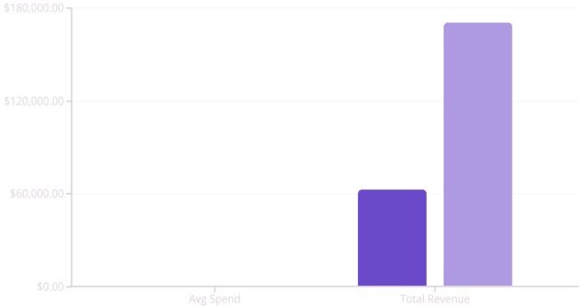
Subscription Status Comparison
Subscribers
Non-Subscribers
27% subscribers (1,053 customers) vs 73% non-subscribers (2,847 customers). Similar average spend suggests untapped subscription growth potential.
Of 3,476 repeat buyers (>5 purchases), only 958 are subscribers – significant conversion opportunity exists.

Slide 9


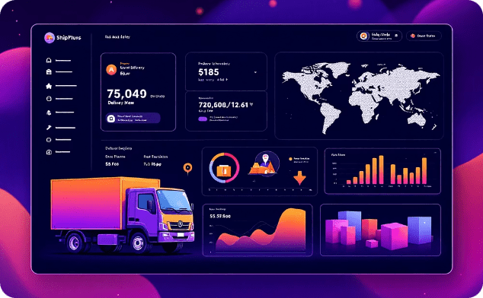
Interactive Dashboard Insights
Customer Distribution
Revenue Analysis
Shipping Patterns
Visual breakdown by subscription status, gender, and category preferences
Category and age group performance metrics with comparative insights
Express shipping users spend $2 more on average than standard shipping

Slide 10
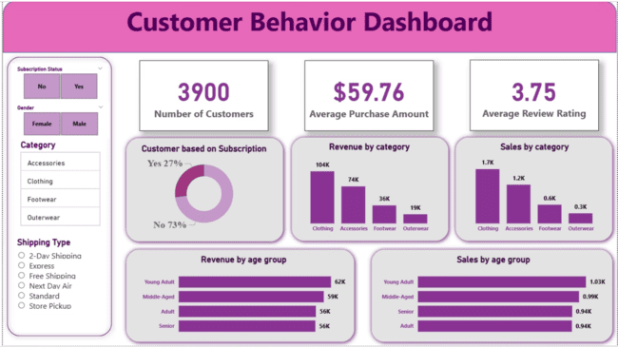

Slide 11




Strategic Recommendations
Boost Subscriptions
Promote exclusive benefits to convert 2,518 repeat buyers into subscribers
Loyalty Programs
Reward repeat buyers to grow the 79.9% loyal customer segment
Targeted Marketing
Focus on high-revenue young adults and express-shipping users
Balance discount policies to maintain margins while highlighting top-rated products in campaigns.

